Slide 1
The predictability of life course
Applied Statistics Project
Students
MASSIN Keryann
VEILLON Juliette
ANDRU Kilian
LACOUR Xavier
Supervisors
M. TROPF Felix
M. PETEV Ivaylo

Slide 2
Introduction
I – Presentation and Data cleaning
II – Creation of the Health Index
III – First machine learning procedures
IV – Second machine learning procedures
Conclusion

Slide 3
I – Presentation and Data cleaning
3 databases from the Health and Retirement Study
Socioeconomic data
Genetic data
42,233 individuals and 15,104 variables
Need for dimension reduction
Imputable and non-imputable missing values
Reduction of the number of variables to 4,147

Slide 4
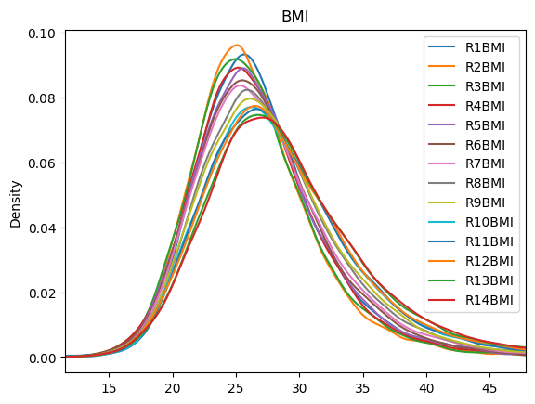
II – Creation of the Health Index
Global Health Index to summarize health-related information
Selection of 27 pertinent variables
Descriptive statistics
 | R1HEART = 0 | R1HEART = 1
R1HIBP = 0 | 7094 | 690
R1HIBP = 1 | 3892 | 976
Contingency table of heart issues against hypertension in wave 1
Density of the variable BMI for each wave

Slide 5
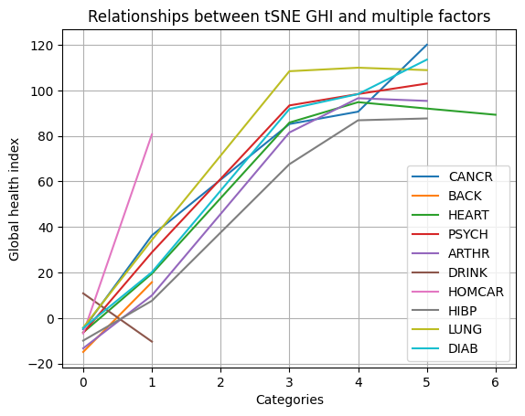
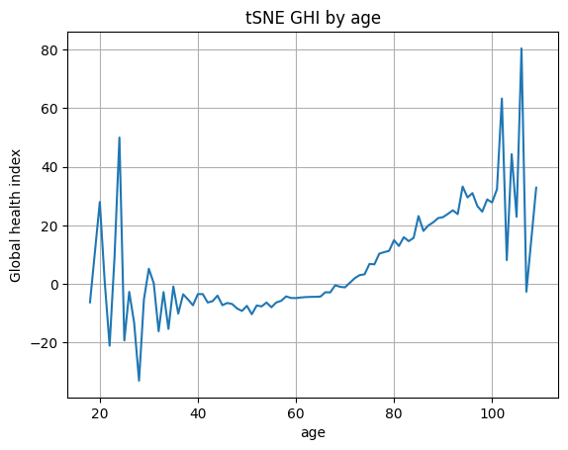
II – Creation of the Health Index
T-distributed Stochastic Neighbor Embedding
Tests of robustness

Slide 6
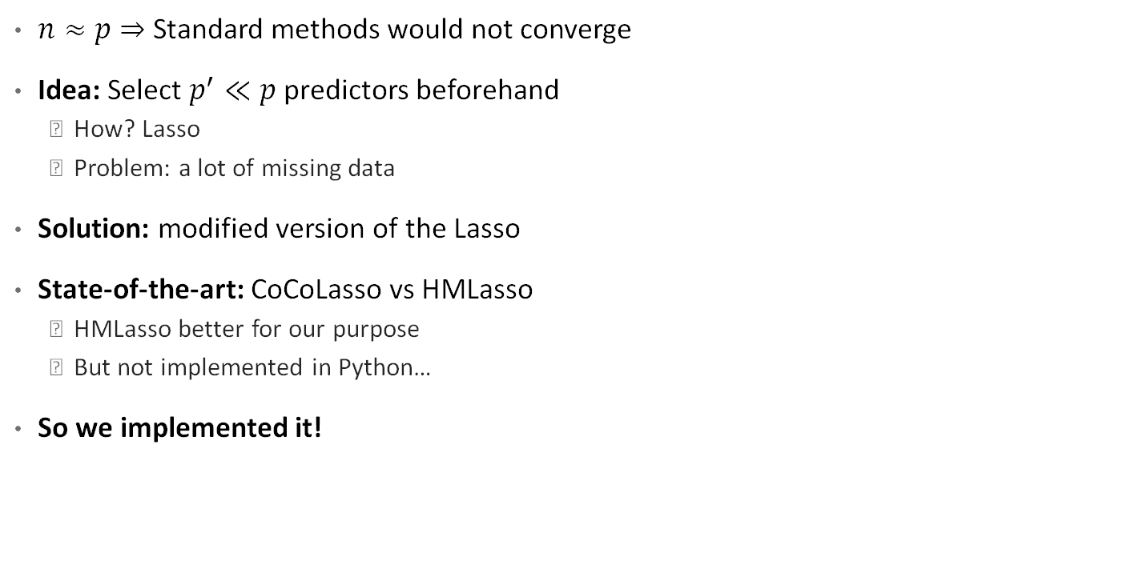
III – First machine learning procedures
$n≈p$ $⇒$ Standard methods would not converge
Idea: Select $p^{′}≪p$ predictors beforehand
How? Lasso
Problem: a lot of missing data
Solution: modified version of the Lasso
State-of-the-art: CoCoLasso vs HMLasso
HMLasso better for our purpose
But not implemented in Python…
So we implemented it!

Slide 7
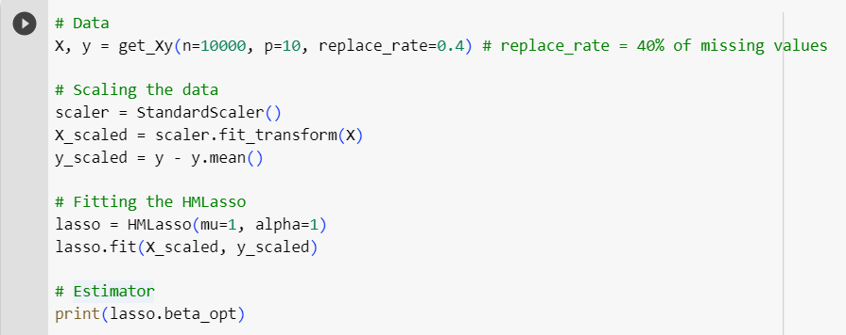

III – First machine learning procedures
HMLasso in Python
CVXPY library → solver
Scikit-learn like interface
Useful to select predictors
On our data, huge gain
$p=4, 147⇒p^{′}=1500$
We can drop columns 6 and 9

Slide 8
IV – Second machine learning procedures
Two kind of methods
Linear methods:
2SLS
Within regression
Tree Based Methods:
XGBoost
RandomForest

Slide 9
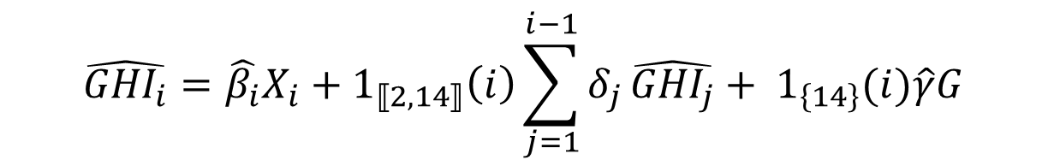
IV – Second machine learning procedures Linear methods – 2SLS
Principle
Create a different lasso regression for each wave
We use the previous estimated GHIs to help determine the next one
How to modulate the model?
Penalisation
Lasso-type used
Type of imputation
$$\hat{{GHI}_{i}}=\hat{β_{i}}X_{i}+1_{⟦2,14⟧}\left(i\right)\sum_{j=1}^{i−1}{δ_{j}}\hat{{GHI}_{j}}+ 1_{\left\{14\right\}}(i)\hat{γ}G$$

Slide 10
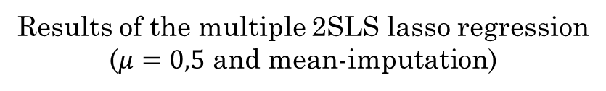
IV – Second machine learning procedures Linear methods – 2SLS
Results:
Data | Testing set's R² | Testing set's RMSE
With genetic data | 0.284062 | 48.032847
Without genetic data | 0.276727 | 48.278280
Results of the multiple 2SLS lasso regression ($μ=0,5$ and mean-imputation)
There is no real improvement of the R²

Slide 11
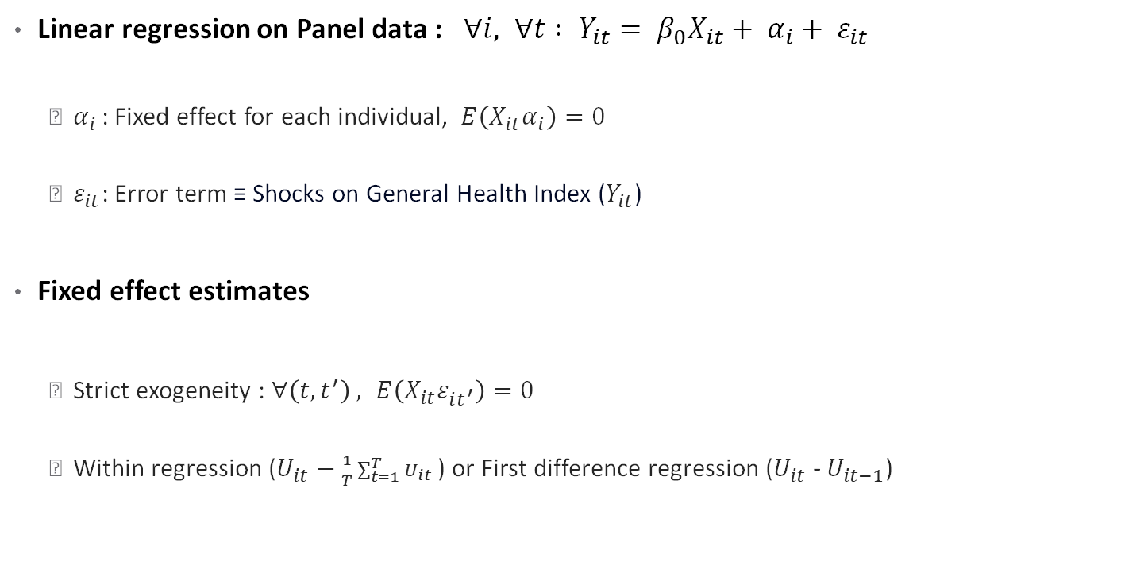
IV – Second machine learning procedures Linear methods – Within Regression
Linear regression on Panel data : $∀i, ∀t : Y_{it}= β_{0}X_{it}+ α_{i}+ ε_{it}$
$α_{i}$ : Fixed effect for each individual, $E\left(X_{it}α_{i}\right)=0$
$ε_{it}$: Error term ≡ Shocks on General Health Index ($Y_{it}$)
Fixed effect estimates
Strict exogeneity : $∀\left(t,t^{′}\right) , E\left(X_{it}ε_{it^{′}}\right)=0$
Within regression ($U_{it}−\frac{1}{T}\sum_{t=1}^{T}{U_{it}}$) or First difference regression ($U_{it}$ - $U_{it−1}$)

Slide 12
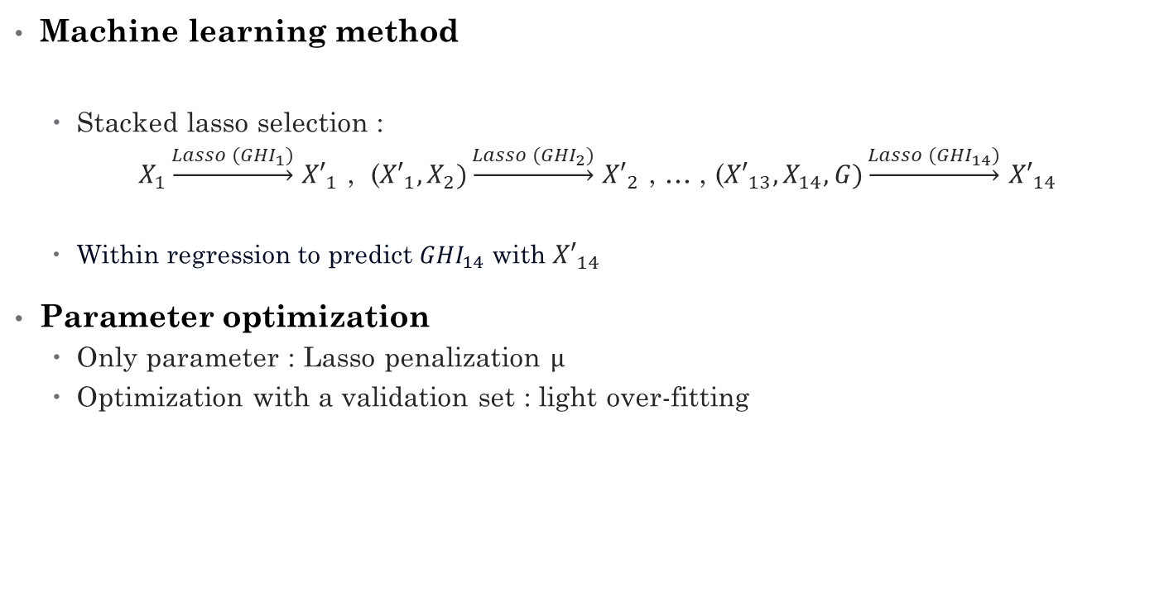
IV – Second machine learning procedures Linear methods – Within Regression
Machine learning method
Stacked lasso selection :
$X_{1}\underset{→}{Lasso ({GHI}_{1})}$ ${X′}_{1}$ , (${X′}_{1},X_{2})\underset{→}{Lasso ({GHI}_{2})}$ ${X′}_{2}$ , … , (${X′}_{13},X_{14},G)\underset{→}{Lasso ({GHI}_{14})}$ ${X′}_{14}$
Within regression to predict ${GHI}_{14}$ with ${X′}_{14}$
Parameter optimization
Only parameter : Lasso penalization $μ$
Optimization with a validation set : light over-fitting

Slide 13
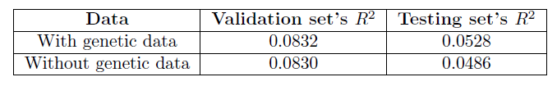
IV – Second machine learning procedures Linear methods – Within Regression
Results :
Genetics variables :
3 genetic variables kept in this method
First method (Within transformation after Lasso selection)

Slide 14
IV – Second machine learning procedures Tree Based methods – XGBoost
Fragile Family Challenge: XGBoost provided powerful results
Let’s give it a try!
What is it?
Gradient Boosting Method

Slide 15
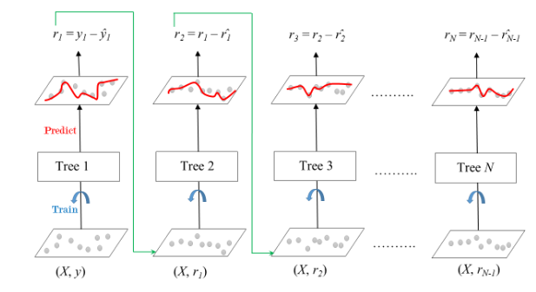

IV – Second machine learning procedures Tree Based methods – XGBoost
Fragile Family Challenge: XGBoost provided powerful results
Let’s give it a try!
What is it?
Gradient Boosting Method
Idea: greedily construct
$f\left(x\right)=\sum_{i≤N}{{Tree}_{i}\left(x\right)}$
XGBoost: algorithm of
Gradient Boosting that handle
missing values
Run extremely fastly!
Source: https://www.geeksforgeeks.org/ml-gradient-boosting/

Slide 16
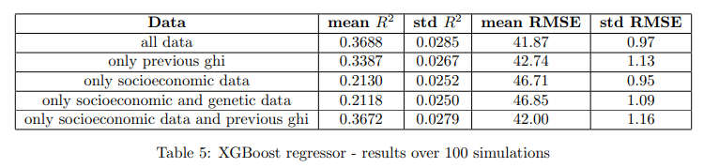
IV – Second machine learning procedures Tree Based methods – XGBoost
On our data
Regression
Optimized hyperparameters using cross-validation
Results:
Good results!
Unable to identify the effect of genetic variables

Slide 17
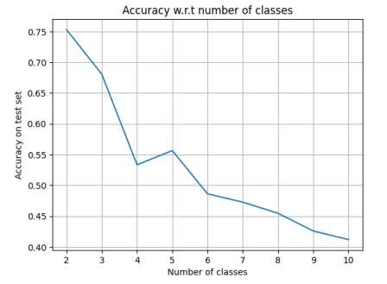

IV – Second machine learning procedures Tree Based methods – XGBoost
On our data
Regression $⇒$ what about classification?
Is GHI = 99 really worse than GHI = 100?
For 2 categories {bad health, good health},
75,31% of accuracy
1,51 times better than dummy classifier
For 10 categories,
41,21% of accuracy
4,12 times better than dummy classifier!

Slide 18
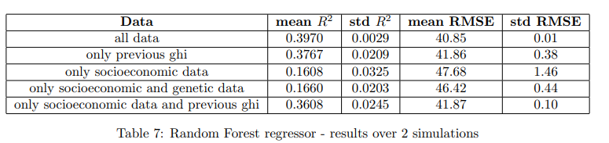
IV – Second machine learning procedures Tree Based methods – Random Forest
On our data
Regression
Optimized hyperparameters using cross-validation
Results:
Strong prediction power!

Slide 19
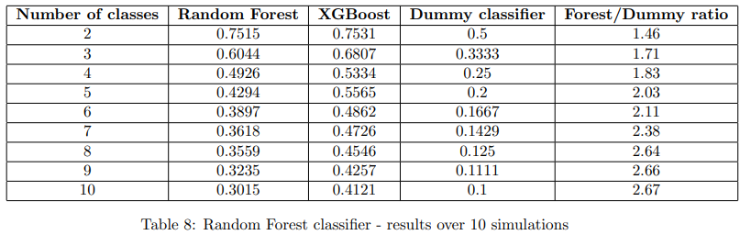
IV – Second machine learning procedures Tree Based methods – Random Forest
On our data
Classification
Results:
Random Forest < XGBoost

Slide 20
Conclusion
Creation of an index to summarize health
Application of linear methods and trees based methods
Success of prediction (XGBoost classifier and Random forest regressor)
Usefulness of genetic variables ?
Possible improvements

Slide 21


Annexe Tree Based methods – Random Forest
Boosting works. What about bagging?
Random Forest vs Gradient Boosting
What is it?
Idea: parallelise the training of decision trees
Wisdom of crowds $⇒$ Majority-voting to predict
a class
How? Database boostrap
Source: https://en.wikipedia.org/wiki/Random_forest

